Slide 1
Vehicle Counting Method
Based on Digital Image Processing Algorithms
DIGITAL IMAGE PROCESSING - CS7.404.M21
Monsoon 2021

Slide 2
Primage Imocessors
Aditya (2021701010)
Bhoomeendra (2021701037)
Dhruv (2021701021)
Prateek (2021701009)
TA: Anushree Korturti

Slide 3
Introduction
The vehicle counting procedure offers accurate data on traffic flow and traffic peak times on highways.
Using digital image processing technologies on traffic camera videos will fast and reliable strategy for achieving these goals.

Slide 4
Agenda
Compare and understand the original method with our improved method for vehicle detection and tracking.
Project Overview
Detection Zone
Image Enhancement
Motion Analysis
Vehicle Tracking
Classification
Counting

Slide 5
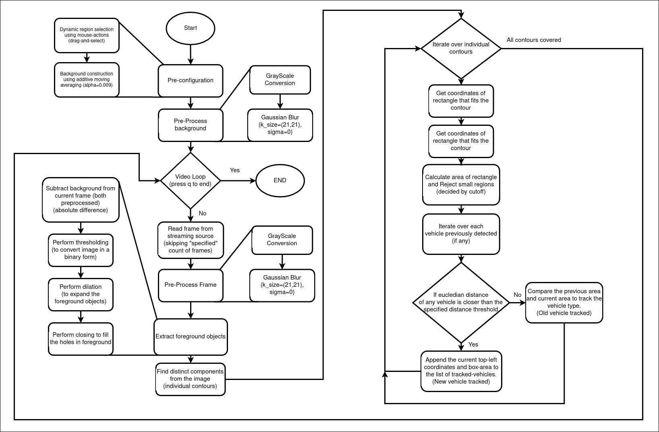
Flow chart of proposed method

Slide 6
Assumptions
With Paper Replication:
No sudden changes of directions are expected.
No car accidents and crashes are expected.
For Both Methods:
There is both physical and legal limitations for vehicles.
Motion scenes are captured with a view from above the roadway surface.

Slide 7
Detection Zone
Proposed In Paper
Modification
This zone is in the middle of the screen and covers 1/3 of its height and 3/5 of its width
This is useful as only a specific part of the frame has vehicles and this detection zone method greatly reduces the overhead of processing
The detection zone is made dynamic which can be defined by the user by drawing boxes in configuration mode as opposed to a static region as proposed in the paper

Slide 8
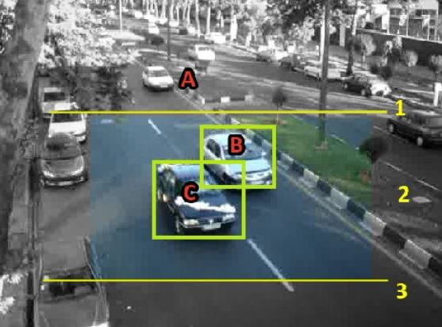
Proposed In Paper
Modification
Static Detection Zone
Dynamic Detection Zone

Slide 9
Image Preprocessing
Proposed In Paper
Modification
Converting the frames from RGB to Gray as color information is not needed.
Applied Gamma transform with factor 1.2 to make edges more prominent.
Thresholding on sobel filtered images to obtain binary edge image.
Applying Gaussian smoothing on Gray Frames to suppress noises.

Slide 10
Motion Analysis
Proposed In Paper
Modification
Took differences of frames by subtracting two sequential pair of generated binary images.
BI ( S (F_{n-1}) ∩ S (F_{n}) ) – BI( S (F_{n}) ∩ S (F_{n+1}) )
Background is constructed in the config step using “moving average method”.
Thresholding is applied on frame differences to obtain binary image
Iterative dilation followed by closing operation is performed on the difference image to better segment the vehicle and find contours on it.

Slide 11
Modification
Background construction with moving averages

Slide 12
Vehicle Tracking:
Proposed In Paper
Modification
Kalman filter can optimally estimate the current position of each vehicle and also predict the location of vehicles in future video frames which helps us to track vehicles using euclidean norm .
For each moving object a Kalman filter is assigned essentially to estimate & track the vehicles as well as minimize noises.
And the number of kalman filter generated equals total counts of vehicles.
Background generated from “moving average” method is subtracted from the current frame to produce crisp shape of moving entities.
Using this information, through nearest neighbor trick we can track the vehicles as a result kalman filtering is no longer needed.
Pros:
Performs well on curved roads.
Enhances our performance by reducing computation time.

Slide 13
Improved Version
Nearest Neighbor trick:
As name suggest, we track the vehicle by “connecting the bounding boxes“.
Exploiting the continuity of moving vehicle one can assert that at time-step “t+1” the bounding box must have moved by some 𝞊 (> 0) distance than at time-step “t”.

Slide 14
Proposed In Paper
Modification
Vehicle detection using methods proposed in paper.
Vehicle detection using improved method with background subtraction.

Slide 15
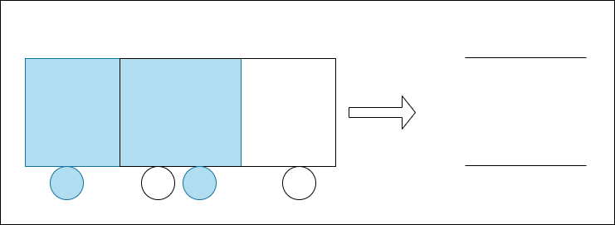
Issues:
Taking intersection of Edge Images (due to Sobel) looses vehicle information.
At time = t-1
At time = t

Slide 16
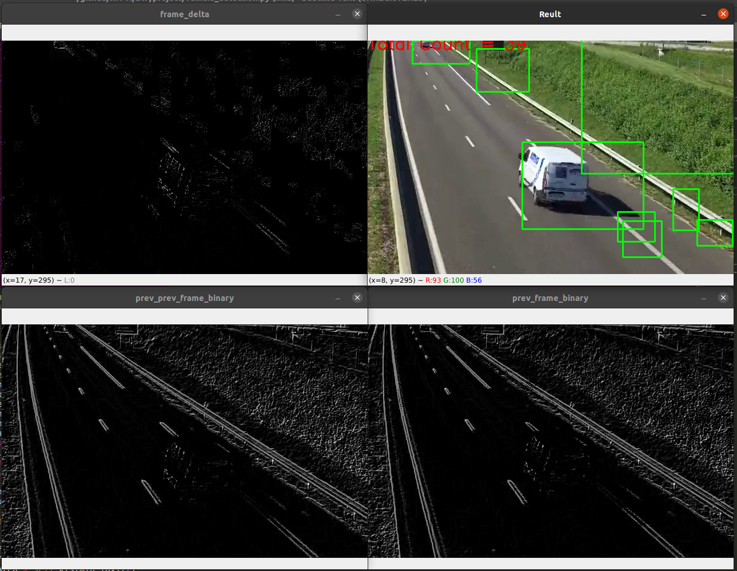
Vehicles almost disappear

Slide 17
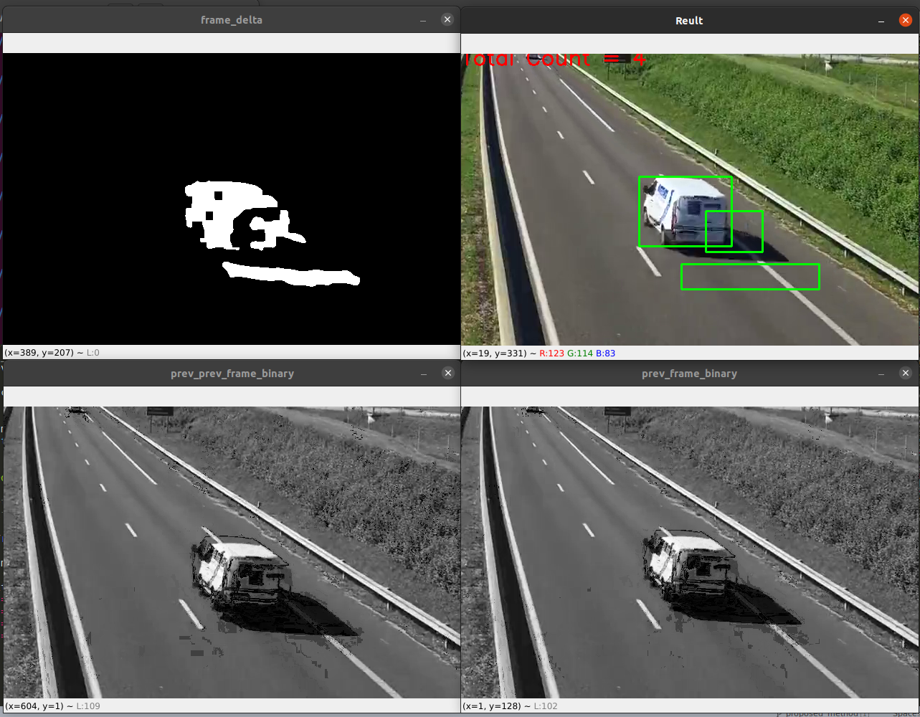
Even if we avoid taking intersection of edge images, subtracting the forward sequential pair (i.e., Nth and (N+1)th) from backward one (i.e., Nth and (N-1)th) tends to produce two disconnected components.
N-2 and N-1
N and N-1

Slide 18
Rectifying previous issues seems to work somewhat better. But, with initial coordinates of bounding boxes (say, upto five), the Kalman Filter is unable to predict or estimate the correct position of bounding box in long run.

Slide 19
Solutions
Instead of edge differencing, take absolute difference of t and (t-1)th gray-scale frames to perform background subtraction Apply thresholding to obtain binary frame with unwanted noises removed.
Perform Dilation to fill up any background holes that may cause discontinuity in our required component.
Provide (t-1)th time-step coordinate to Kalman Filter helps updating the the transition matrix, F_{t} , and measurement matrix, H_{t}. that helps in estimating the the t time-step bounding-box coordinates accurately.
Plus, tuning thresholds for bounding-boxes area ends up giving better results.

Slide 20
Classification Criteria:
On the basis of vehicle size, we classify them into 4 types:
Type 1 (Bicycle, MotorCycle)
Type 2 (Car)
Type 3 (Pickup, Minibus)
Type 4 (Buses, Trucks, Trailers)
Extreme case: For a partially captured vehicle, initially it maybe mis-classified but it is handled later as we consider the largest area till the vehicle is in the frame.

Slide 21
Counting:
Ground Truth values for each group of vehicles are “manually” counted from a given video.
Further, when an untracked vehicle enters the “detection zone” it is added to the total count as well as classified into one of the mentioned groups by updating the count of that particular category.

Slide 22
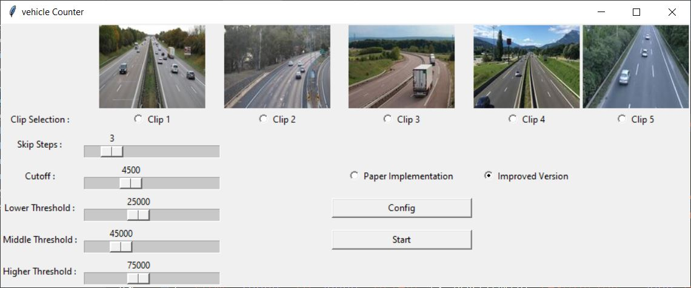
GUI

Slide 23
Analysis & Results:
Paper Implementation
Improved Version
Actual vehicle passed | Counted number of vehicles by the method | Number of errors
44 | 52 | 18.18%
Actual vehicle passed | Counted number of vehicles by the method | Number of errors
44 | 42 | 4.54%

Slide 24
Results - Contd...
Prediction
Prediction
Type 1 Type 2 Type 3 Type 4
Type 1 Type 2 Type 3 Type 4
Type 1
Type 2
Type 3
Type 4
Noise
1 | 0 | 0 | 0
2 | 25 | 0 | 0
0 | 1 | 10 | 0
0 | 0 | 2 | 3
8 | 0 | 0 | 0
Type 1
Type 2
Type 3
Type 4
Noise
0 | 0 | 0 | 0
1 | 28 | 0 | 0
0 | 0 | 10 | 0
0 | 0 | 0 | 3
0 | 0 | 0 | 0
Ground Truth
Ground Truth
Confusion Matrix for Paper Implementation
Confusion Matrix for Improved Version
Accuracy = (39/44)*100 = 88.63
Accuracy = (43/44)*100 = 97.72

Slide 25
Improvements...
Using pattern recognition methods to recognize the vehicle types according to their structural shapes (e.g., pre-trained deep learning models).
Using a combination of vehicle shape and occupy pixels.
Defining isolated detection areas for each roadway vehicle lines.

Slide 26
Conclusion...
Since this technique is based on image processing algorithms this strategy proved to be cost effective.
Plus, it can be easily supported by Edge devices.
And seeing the results from our modified method, we can ensure for its suitability for vehicle detection and traffic flow analysis purposes.
Further, with Kalman Filtering method we’re unable to track vehicles moving on curved roads as well as on highway (vehicles moving in either directions).

Slide 27
References:
[2D object tracking using Kalman Filter]
[Vehicle Counting Method Based on Digital Image Processing Algorithms]
[T. Le, M. Combs, Q. Yang, “Vehicle Tracking based on Kalman Filter Algorithm,” Technical Reports Published by the MSU Department of Computer Science, ID: MSU-CS-2013-02, 2013. ]
Video 1, 2 and 3 taken from youtube
Video 4
Video 5

Slide 28
Thank You!

